Slide 1
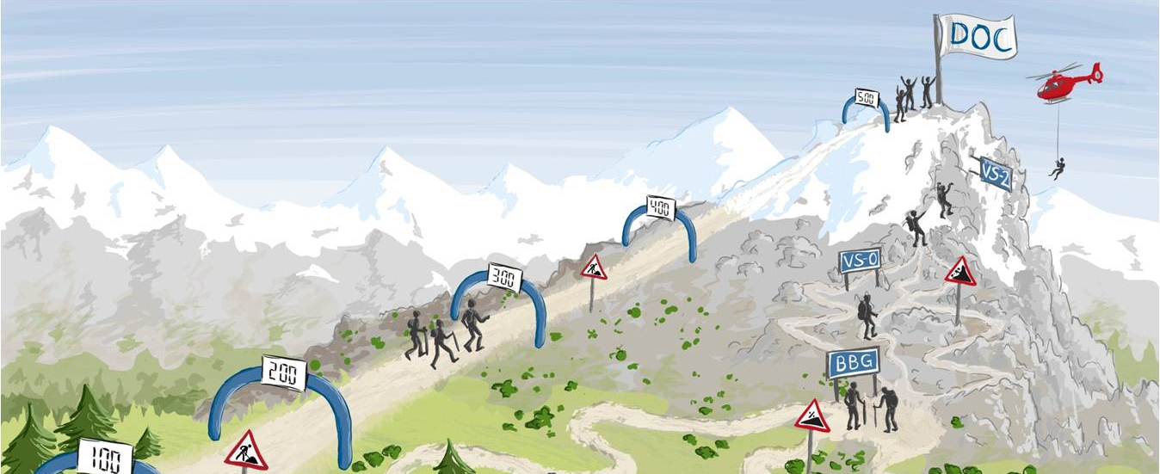

EG-7, EG-25, V4.3, April 2014
Maturity Level management.
CommuniCation.

Slide 2
Maturity level management stands for…
      Obvious maturity progress
      Enabling – not just measuring
      Binding maturity level-target-planning
      Target defaults
      Consistent EMT criteria
      Transparency
      Early warning
      Quality-adapted maturity of product and process
      Clear responsibilities
      Understanding of functional chains
      Improved inputs
      Less PLTs and Task Forces
      Integration of EMT features and components
      Synchronisation
Slide 2

Slide 3
Despite of first success there are still several challenges.
Management‘s direct quotes relating to RGM.
      „Maturity Level Management helps to improve the maturity and qualitity of products significantly, starting from the strategic preliminary clarification to the DOC.“
      „The further focus of ProGF lies on the implementation of a permanent EMT Maturity Level Management for all vehicle projects.“
Head of Tx
Head of Ex
      „An additional outcome is a distinct increase of maturity concerning the painted car body.“
„The key prerequitsite for further progress is to comply with and to meet consequently the maturity requirement and inputs of all CoCs involved.“
Head of Tx
      „EMT Maturity Level Management gives a good overview on topics and their cross-linkages and helps to bring together all relevant contact persons.“
Head of Tx
„The target to build up the best BBG so far has been reached - also due to RGM! But there is no reason to rest. In PVL we have to achieve a further maturity progress – additionally to other maturity progress!“
Module leader
Head of Lx-x
„It is positive that the RGM project team is aware of the complexity and implications of the RGM topic. This is why I totally approve a step-by-step proceeding in roll-out.“
„Just two suppliers with maturity agreements had quitted. But we were successful in retracting them…“
Head of CoC Ex-xx
Head of Lx-x
Slide 3

Slide 4



In Pilot projcts prior concrete sucess has been achieved.
Direct Quotes FROM Pilot Projects G11/12, G30, F56 ANd F60.
      „… target-oriented dialogue between EV and FGV…“
      „Relating to G11/G12 we‘ve found three critical components which wouldn‘t have been discovered inevitably without RGM.“
      „Suppliers are sensibilised concerning the quality of components.“
      „… because of the improved QMT-assistance we‘ve obtained test components from a first Q-loop by Cubing date.“
      „Due to the piloting of RGMs several topics have been arisen which wouldn‘t have been disovered so early otherwise.“
      „The event [Audit VKBG Akustik] has never taken place before in this way. EV appreciated this fact because potential risky components could be discovered at an early stage and tasks could be distributed.“
      „Thanks to Maturity Level Management we have a good overview on the points we have to provide support for.“
      „Due to Maturity Level Management transparency towards VKBG has increased obviously.“
      „… different expectations become transparent and can be targeted with measures at an early stage.“
      „Because of the Maturity Level Agreement we question information and thus, a common understanding is created.“
Slide 4

Slide 5
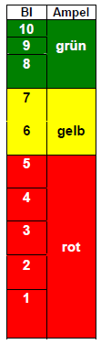
Benefit of a central maturity level management.
Significant improvement of time, quality and costs.
Problem
Areas
Actual
TARGET
∆ Q, T, K
SOP
DOC
Strategic
Initial
Architecture
Product
Serial Development Stage
BI>7
Development
Stage
Draft Stage
Draft Stage
Predefined Target Maturity-Goals for the specific maturity gates are defined contentually in an EMT context and are objectively measurable .
Transparent Maturity-Verification by continuous testing of subsystem- and total vehicle-features per maturity gates.
Every variance from the target is listed in the risk and measures management.
Predefined Maturity Goals will be fulfilled to defined maturity gates.
Empowerment DOC Maturity by reinforcement ramp-up plant.
Slide 5

Slide 6
Maturity Level Management defines
Maturity step, level, Element and
progress.
By analogy with established I-steps of process chain E/E, there will be in future an EMT Maturity Level Management covering all total vehicle features, customer functions and components with maturity steps and related maturity levels.
Maturity Step ⇨ When will be measured?
A maturity step is an agreed baseline across all process chains, in which the agreed state of development is established, confirmed, and released for this specific time frame.
Maturity steps will be realized to clearly defined time frames in ItO.
Maturity Level ⇨ Which contentual demand has to be fulfilled?
The function of the maturity level is to define the product and process maturity and is scaled from RG 0 to RG 6, by analogy with the E/E-process chain.
Maturity Element ⇨ What will be measured?
Maturity elements are KIFA-components and total vehicle features/ functions across the E, M, and T divisions (e.g. acoustics, passive safety, assembly, installation and manufacturability).
Maturity Progress ⇨ How strong is the maturity‘s improvement over time?
The maturity progress is the development of the maturity along a defined time frame, e.g. between maturity step x and x+1.
Slide 6

Slide 7
EMT Maturity level - Definition and Scale.
Maturity level 0 | Maturity aspects concerning product implementation: - No implementation. No driving permission (stage 0). Maturity aspects concerning process requirements: - Strategic goals are defined and consistent to each other. - Interactions between maturity elements (features/ functions/ component) are familiar, but not conceptually represented. - Lessons Learned and SSA are available. - Propositions for creating rough concepts of production technologies are available.
Maturity level 1 | Maturity aspects concerning product implementation: - Maturity element is specified, requirements ZAK on right side are defined and conceptually (virtually and/ or hardware) represented. - Maturity element is partly implemented. - Maturity element is representable at subsystem level. - Measures for the attainment of vehicle features based on KMG planned status are familiar. - Basic manufacturing feasibility concerning conceptual topics is evaluated. Driving permission depending on special driving training and approval of prototypes (stage 1). Maturity aspects concerning process requirements: - Specification sheet is free for supplier demand. - EKGQ-derived targets are finished. - Rough concenpts of production technologies are available and are evaluated with regard to the propositions.
Maturity level 2 | Maturity aspects concerning product implementation: - Maturity element is completely (virtual and/ or hardware) represented, requirements ZAK on right side are confirmed and integratable concerning GFZ. - Maturity element is completely implemented. - Maturity element is represented within the phase-specific target range at subsystem level and partly suitable for trial. - Familiar measures for the attainment of vehicle features are evaluated with EKGQ and expedient. - Need for action resulting from manufacturing feasibility is evaluated on total vehicle level and it is expedient. - Specific driving permission for development partners with special driving training in accordance with the Guideline (stage 1). Maturity aspects concerning process requirements: - Requirement specification is free for development goal.
Maturity level 3 | Maturity aspects concerning product implementation: Maturity element is completely represented intotal vehicle and suitable for trial in defined operating conditions. It is agreed upon implementation of measures for goal attainment of vehicle features. - It is agreed upon need for action resulting from manufacturing feasibility on component level. Conditional driving permission for development partners outside of the testing ground (stage 2). Maturity aspects concerning process requirements: - Supplier of series is nominated (if necessary, components from series-production materials).
Maturity level 4 | Maturity aspects concerning product implementation: - Maturity element is completely represented in total vehicle, suitable for trial under all environmental conditions and complete integration is safeguarded without collision. - Evaluated measures of goal attainment DOC are mostly decided. - Manufacturing feasibility on component level is confirmed. Conditional driving permission for drivers with specific driving training (stage 3). Maturity aspects concerning process requirements: - Components of series-production materials provided by series supplier.
Maturity level 5 | Maturity aspects concerning product implementation: - Maturity element is completely represented in total vehicle without limitations. - Maturity elements are ready for type testing and homologation. - Manufacturing feasibility on component level is proved by series tool. Street driving permission without limitations (stage 3). Maturity aspects concerning process requirements: - Components of series tool and series production.
Maturity level 6 | Maturity aspects concerning product implementation: - Maturity element is ready for series production. - Maturity element is represented in all treated versions without limitations. Usage without limitations with street driving permission (stage 4). Maturity aspects concerning process requirements: Stabile series process. Process capability of production systems is confirmed.
Slide 7
Implementation of maturity levels is related to the end of a maturity step

Slide 8
Impact coherence Between
Maturity step and Maturity level.
schematic
Maturity Levels
RG 6
Generic Maturity Level Planning
RG 6
RG 5
Element *1
Element* 2
RG 4
Element* 3
RG 4
RG 3
RG 2
RG 1
RG 0
Maturity Step
0
Maturity Step
100
Maturity Step
150
Maturity Step
200
Maturity Step
300
Maturity Step
400
Maturity Step
500
Maturity Step: When will be measured?
Maturity Level: Which contentual demand has to be fulfilled?
Maturity Element: What will be measured?
Maturity Progress: How strong is the maturity‘s improvement?
* Elements are total vehicle features, functions and components.
Slide 8

Slide 9
Processes in maturity LEVEL management adapted to Virtual / HW Prototypes* iN ItO.
xxMvS
xxMvS
xxMvS
xxMvS
xxMvS
xxMvS
xxMvS
xxMvS
xMvS
Strategy
develop-
ment phase
Initial
phase
Concptual
phase
architecture
Product
concept
phase
Series
development
phase
Order for
strategic
development
Order for
initial phase
Confirmation
of target frame
Confirmation
of target frame
for derivatives
Target
agreement for architecture
+ confirmation of business plan for derivative
Ramp-up
confirmation
Target agreement for
derivative
Concept
confirmation
Product
confirmation
VABG0
VABG2
VBBG
Schematic
VABG1
VKBG
VSBG
The liustration may differ proportionally from reality.
PVL/VS0
MT
BBG
VS1/VS2
Architecture
RS 0
MT
BBG
PVL/VS0
VS1/VS2
RS 100
RS 150
Maturity step planning
RS 180
(virtual)
Maturity level-target-planning
RS 180
(Hardware)
RS 400
(Hardware)
Derivative
RS 200
RS300
(virtual)
Maturity step planning
RS 300
(Hardware)
Maturity level-target-planning
Process of a maturity gate
RS 400
(virtual)
RS 500
Slide 9
Note: Time frames based on ItO incl. set-up and trial time * ramp-up 07er

Slide 10

Maturity Development
From Component to total vehicle
Maturity verification and Acceptance.
Ticket for Testing
Complete
Vehicle
Complete
Vehicle
Vehicle
User
Ticket for Assembly
Plant
Subsystem
S
Sub-
system
Ticket for Assembly
Component
User Assembling
Ticket = Maturity verification by supplier (respective maturity agreement)
Lights = Maturity confirmation by consumer (customer)
Producer of Component
Slide 10

Slide 11

Adjustment of Maturity level within the scope of implementation Planning.
Schematic
Adjustment
Expectation
TARGET-level
Confirmation
TARGET-level
e.g.
feature/
component/
function (E-M-T)
e.g.
component/
function
Handshake
Expectation:
Maturity level
Features/
functions
(time appropriate)
Confirmation:
Maturity level (achievable)
Features/
functions
(achievable)
2 – Possibilities of situation:
Expectation = Confirmation ⇨ No need for clarification
Expectation ≠ Confirmation ⇨ Need for clarification
Slide 11

Slide 12

Cascade of Maturity Requirements and Agreement pending supplier.
Product features/ Quality
Production/ Assembling planning
(Ramp-up plant)
Maturity requirements
Total vehicle
Responsibility for feature
Responsibility for feature
Maturity requirements
Assembling
Responsi-
bility for
product
approval
Maturity requirements
System/ component
Responsi-
bility for
product
approval
Maturity requirements
Devices
Supplier*¹ (component)*²
Suplier (manufacturing equipment)*³
Maturity requirements
Component
Man. equipment*¹
*¹ Implementation and proof of BT maturity by supplier
*² Cross-departmental function of M-Ressort to supplier
= Handshake between Expectation and Confirmation
*³ Facilities, machinery, tools, devices, manufacturing equipment, and consumables
Slide 12

Slide 13
maturity level management Process.
A
ItO 02.02.01
ItO 04.05.01
Implementation of continous testing and maturity level planning
Managing and reporting of maturity level
ItO 02.02.01.05
ItO 02.02.01.06
ItO 02.02.01 .08
ItO 04.05.01.02
ItO 04.05.01.03
Initial
maturity step planning
Maturity level-target planning
Verification of maturity level-target planning
Proof of suitability of continous testing
Acceptance report of
maturity step
ItO 02.02.01.07
ItO 02.02.01.09
ItO 04.05.01.01
Rough contionous
testing planning
Detailed continous testing planning
Maturity proof
of supplier
ItO 04.05.01.04
Managing deviations
Kick-Off
maturity step/
Preview
maturity level-target planning
Review of maturity agreement/ Detailed continous testing planning
Completion of maturity level planning incl. forecast of target achievement
Construction of
testing
vehicles
Maturity proof Approval of maturity step
Length of one
maturity step
(cyclical process)
Managing deviations
* Maturity level-target planning is planned at the beginning of a vehicle project, initially for all maturity steps. Hereby, maturity level-target planning and continous testing provide inputs to one another. A comparison of this planning procedure takes place subsequently at the beginning of every single maturity step.
Central
milestones
Review dates
Cyclical pocess part (repetitive)
Generic process part ( singular)
Slide 13
Notes:
C

Slide 14
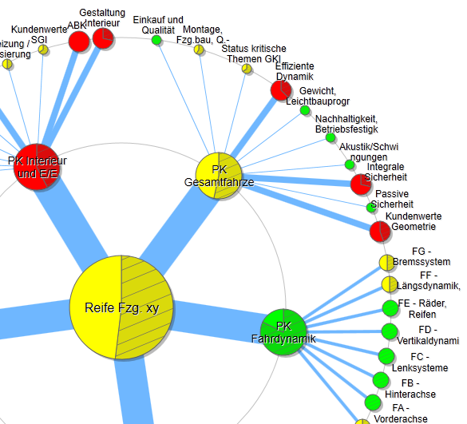
Transparency of maturity regarding
component, Module and total vehicle.
Merging of product and process maturity.
Product and Process Maturity
Reporting
Objective presentation of
total vehicle maturity (actual condition) based on maturity level-target planning and shown by maturity index.
Approval of maturity steps by
- Management Circle ProGF („early stage“)
- Steering Committee Plant 0 (RS 200 for target agreement derivative, RS 300 for DOC forecast BBG and RS 400)
- Steering Committee Receiving Plant (RS 500, as well as handover of vehicle project from plant 0 (TI) to receiving plant (Tx), based on result BBF Event PVL/VS0)
Monitoring and decisions concerning topics of escalation.
Maturity level management is the impulse generator for needs-oriented implementation of process over E, M and T in order to achieve a customer-oriented product and process quality.
Planning, controlling and implementation of processes is aligned to EMT Maturity Level Management.
Slide 14

Slide 15
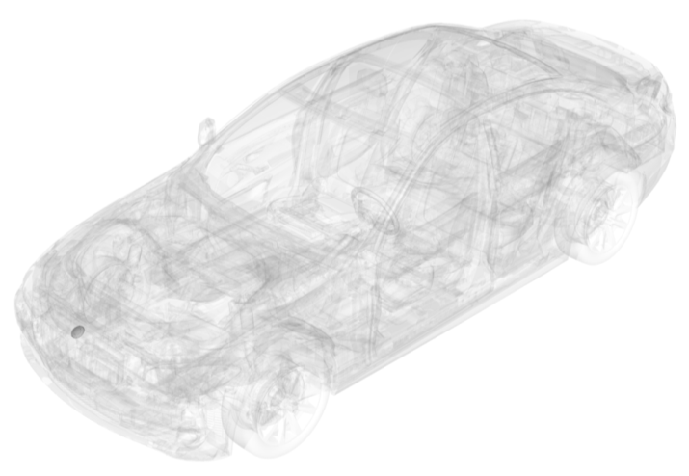
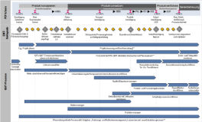
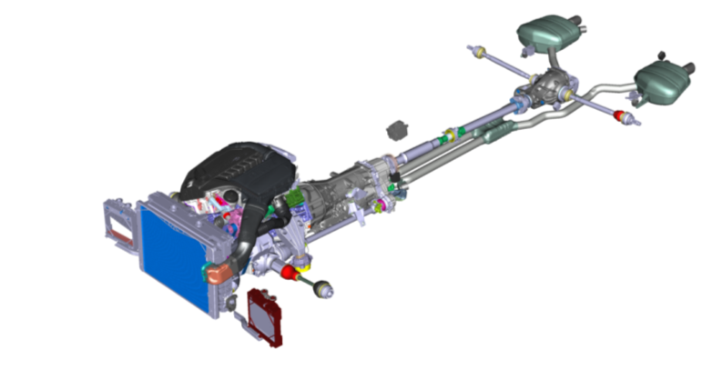
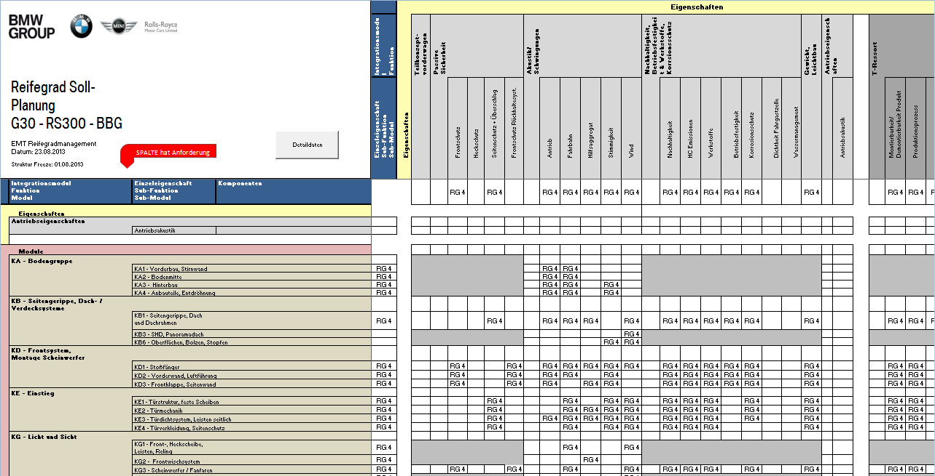
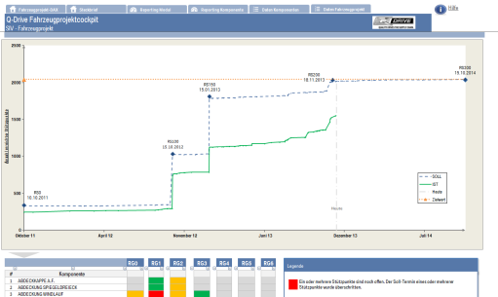


Merging of product and
process maturity towards
Overall maturity.
Product maturity
Process maturity
RGM product maturity
RGM process maturity
QMT SOLL-PROZESS
QMT SOLL-PROZESS
RGM overall maturity
Aggregation of product and process maturity towards overall maturity.
Maturity verification of products by maturity audits in RS.
Maturity verification of processes by documented processes by RG in RS.
RGM maturity index for all selected maturity elements
Product and process maturity are merged into maturity index on total vehicle level.
The view on total vehicle is based on five process chains.
Maturity of process chains is derived from maturity of features, functions and modules.
Slide 15
Notes:
Ergebnis:
Das Reifegradmanagement erzeugt Transparenz über Produkt- und Prozessreifeergebnisse von Komponente, Teilsystem und Gesamtfahrzeug.
Die Produktreife wird im wesentlichen über das E-Ressort gesteuert und beinhaltet die entwicklungsrelevanten Reifeanforderungen aus EMT.
Das M-Ressort synchronisiert seine durchgängigen Prozesse zur Überprüfung der kundenorientierten Qualität von Bauteilen bei BMW und beim Lieferanten mit den Meilensteinen zum Produktreifenachweis.
Um die Aussage einer Gesamtreife eines Fahrzeugprojektes zu treffen werden Produkt- und Prozessreife aggregiert und im Reifeindex gemeinsam dargestellt.

Slide 16
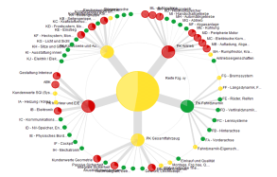

REPorting per maturity step is based on maturity index-Structure.
Maturity gate x
Kick-Off
Maturity step/
Preview Maturity Level planning
Completion
Maturity Le-vel Planning
Construction of
prototype
Approval of maturity step
Main reporting point
Interim report
(if required)
Main reporting point
Interim report
(if required)
Main reporting point
Status
maturity level planning
Completion of
SIV permanent contionous testing/
approval of
maturity step
Interim status:
Maturity level-target agreement
Interim status:
SIV permanent continous testing
Status of maturity level-
target as agreed upon
Slide 16
Notes:
Die durchgängige Absicherung sieht deshalb vor, dass über alle Ebenen und Fachbereiche ein vergleichbarer Prozess angewendet wird, der dann auch von einer leistungsfähigen IT-Toolkette unterstützt werden kann. Der erste Prozessschritt beinhaltet eine ressortübergreifende Absicherungsplanung (virtuell und HW). Daraus lassen sich die Anforderungen an die Reife der Komponenten und Teilsysteme zu den jeweiligen Reifestufen ableiten. Und es wird möglich, die inhaltliche und zeitliche Stimmigkeit der Absicherungsaktivitäten zu beurteilen und die Absicherungskaskade über EMT zu optimieren.
So kann z.B. frühzeitig erkannt werden, falls die Absicherungsvorleistungen der Komponenten und Teilsysteme zu spät eingeplant sind, oder falls zum Zeitpunkt der Serienwerkzeugfreigaben nicht alle Absicherungsergebnisse vorliegen. Es kann gezielt nach Optionen gesucht werden, die Absicherungsschritte vom Gesamtfahrzeug auf die Teilsystemebene oder von der Hardware in die virtuelle Welt zu verlagern.
Im zweiten Schritt wird nach der Beschaffung bzw. nach dem Zusammenbau die Qualität des Absicherungsträgers hinsichtlich der Absicherungstauglichkeit bewertet „ready for testing“. Hier leistet die QMT-Arbeit zur Sicherstellung der Versuchsteilequalität einen wesentlichen Beitrag.
Die Transparenz bzgl. der Qualität der Versuchsteile hilft uns später auch bei der Problemanalyse. Durch die Bewertung der Absicherungstauglichkeit wird klar, welche der geplanten Absicherungsprogramme bei Abweichungen von der geforderten Qualität betroffen sind und es kann frühzeitig reagiert werden und es wird vermieden, dass Absicherungsergebnisse wegen mangelnder Qualität oder veralteten Baustand der Absicherungsträger in Frage gestellt werden.
Nach Durchführung der Absicherungen werden im dritten Schritt im Rahmen der Ergebnisauswertung die geforderte Reife und die Absicherungsvorleistung nachgewiesen. Ziel muss es sein, nur reife Komponenten und Teilsysteme ins Gesamtfahrzeug zu integrieren. Und wir sollten Absicherungsergebnisse noch stärker als bisher zur systematischen Positiv-Bestätigung von Anforderungen nutzen, unterstützt durch eine bessere tooltechnische Vernetzung mit dem Anforderungsmanagement. Damit wir die Frage „wo stehen wir in der Absicherung“ umfassend beantworten können.

Slide 17
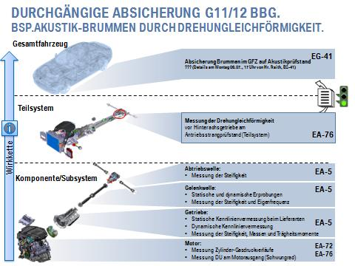
RGM results and Instruments are
transferred in vehicle projects by means
of 4 Transfer Workshops.
Preparation of Roll Out: Kick-Off and tailoring in vehicle project
Agreement upon time lines (basic structure maturity step vehicle-specific)
0
1
Cluster of interfaces
Questionnaire
Transfer
Workshops
0
Relational matrix, maturity level-target-planning, mech. PQ report
1
Permanent planning of continous testing and approval of maturity step
2
2
3
3
4
Implementation of maturity step (Proof of suitability of continous testing and evaluation of continous testing results)
4
Slide 17

Slide 18
Status: 03/2014
RGM‘s Roll-Out is secured by
approach of transfer-Workshop until Q4/2015.
Run-up in number of vehicle projects*
1st phase
2nd phase
3rd and 4th phase
(as planned)
General set-up
Plan
Covering of RGM qualification by application in vehicle project
Product range acc. to RGM Tailoring-Guideline and central roles acc. to process architecture
Available capacity of Maturity Level Managers
Start Transfer-WS
Q4/2013
Q1/2014
Q2/2014
Q3/2014
Q4/2014
Q1/2015
Q2/2015
Q3/2015
Q4/2015
Securing roll-out:
Goal-oriented enabling of target groups in order to achieve a comprehensive implementation in vehicle projects
Initial development of RGM results and instruments in respective vehicle projects and maturity levels (qualification for original work of respective roles)
Four-step transfer concept of RGM results and instruments in vehicle projects
Slide 18
* excl. LCI and only vehicle projects whose maturity step is achievable (acc. to synchronisation plan)

